Slide 1
Energy-efficient Task Offloading and Computing Scheme via Hierarchical Reinforcement Learning
Sinwoong Yun
DGIST
lion4656@dgist.ac.kr
10/May/2019
UGRP Meeting

Slide 2
Motivation
Energy efficient frequency scheduling
CPU consumes energy with regard to its processing frequency
CPU frequency with high level can process task fast
However, this consumes more energy than low level frequency
Tradeoff!
Find optimal frequency level
Minimize computing energy consumption
While satisfying QoS (latency to users)
Wired transmission
BSs are connected with wire
Distribute a load among BSs to prevent one server from becoming congested
Wired transmission consumes a few time, energy
Determine wired transmission strategy via transmission probability

Slide 3
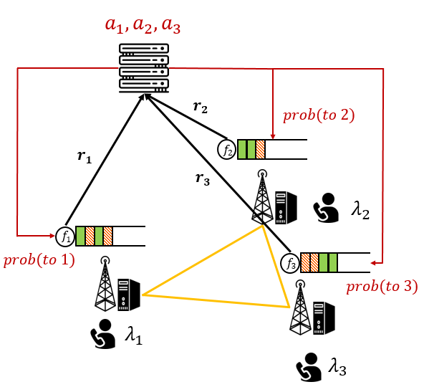
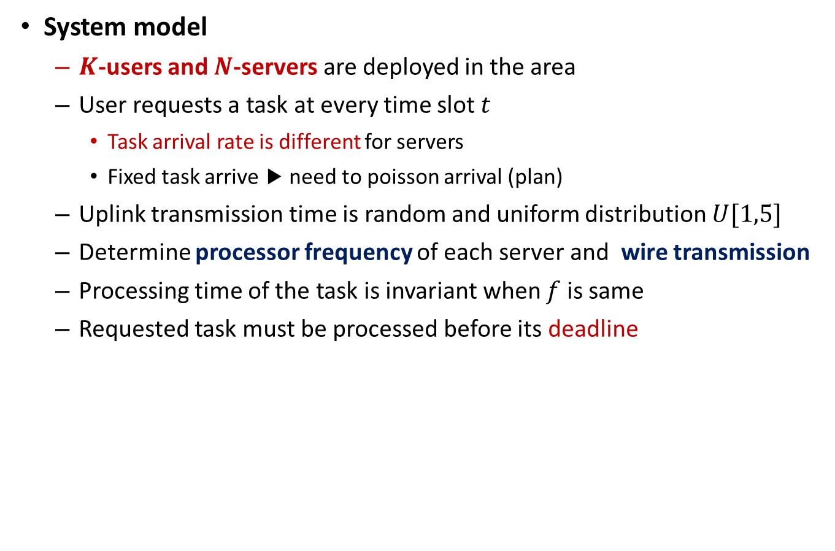
System Model
System model
$K$-users and $N$-servers are deployed in the area
User requests a task at every time slot $t$
Task arrival rate is different for servers
Fixed task arrive ▶ need to poisson arrival (plan)
Uplink transmission time is random and uniform distribution $U[1,5]$
Determine processor frequency of each server and wire transmission
Processing time of the task is invariant when $f$ is same
Requested task must be processed before its deadline

Slide 4

System Model
System model
$K$-users and $N$-servers are deployed in the area
User requests a task at every time slot $t$
Task arrival rate is different for servers
Fixed task arrive ▶ need to poisson arrival (plan)
Uplink transmission time is random and uniform distribution $U[1,5]$
Determine processor utilization of each server and wire transmission
Processing time of the task is invariant when $f$ is same
Requested task must be processed before its deadline

Slide 5
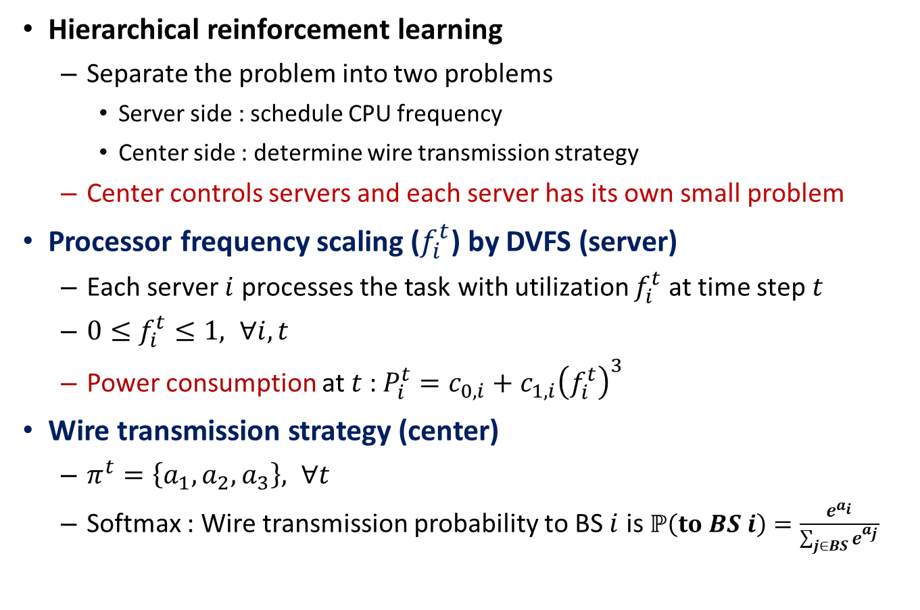
System Model
Hierarchical reinforcement learning
Separate the problem into two problems
Server side : schedule CPU frequency
Center side : determine wire transmission strategy
Center controls servers and each server has its own small problem
Processor frequency scaling ($f_{i}^{t}$) by DVFS (server)
Each server $i$ processes the task with utilization $f_{i}^{t}$ at time step $t$
$0≤f_{i}^{t}≤1, ∀i,t$
Power consumption at $t$ : $P_{i}^{t}=c_{0,i}+c_{1,i}{\left(f_{i}^{t}\right)}^{3}$
Wire transmission strategy (center)
$π^{t}=\left\{a_{1}, a_{2}, a_{3}\right\}, ∀t$
Softmax : Wire transmission probability to BS $i$ is $ℙ\left(to BS i\right)=\frac{e^{a_{i}}}{\sum_{j∈BS}{e^{a_{j}}}}$

Slide 6
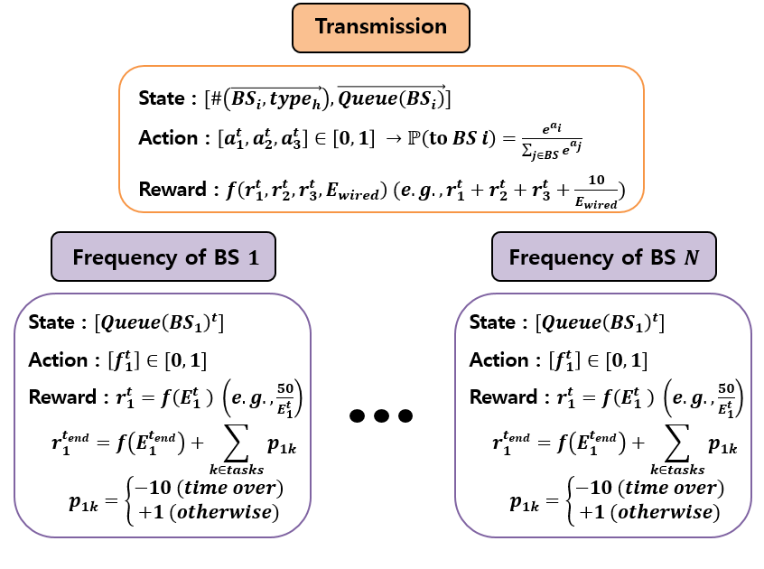
RL formulation

Slide 7
Gym environment structure
Class : Environment
__init__
Initialize parameters, action/state space
reset
Reset reward, time slot, server state (Central/Server)
step
$𝒮,𝒜 → 𝒮^{′},ℛ, done$(Central/Server)
usergen
Generate task request for each time slot
wire_transmission
Decide wire transmission for multiple tasks
is_done
Return central reward and done flag
seed
Setting random seed to reproduce the same result (not use)
render
Display the environment (not use)

Slide 8
Gym environment structure
Class : Server
__init__
Initialize parameters, server queue, uplink tasks
association
BS-user association with random uplink transmission time
Pop one task from arrived tasks
(waiting wired transmission)
arri_pop
wait_update
Give time count to tasks
add_to_queue
Add transmitted task to server computing queue
process
Process the tasks with scheduled frequency

Slide 9
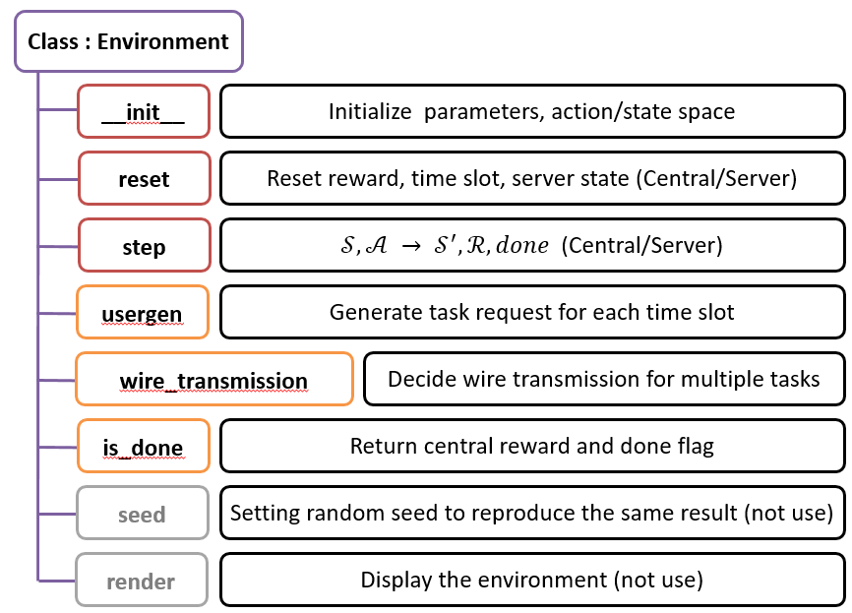
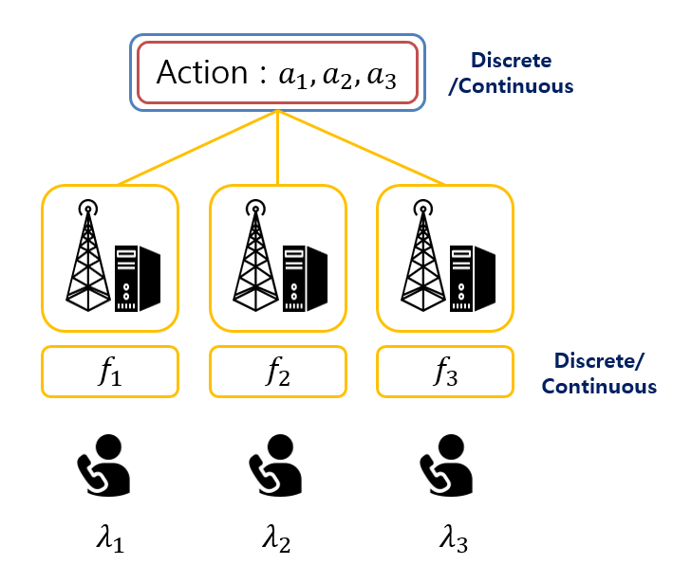
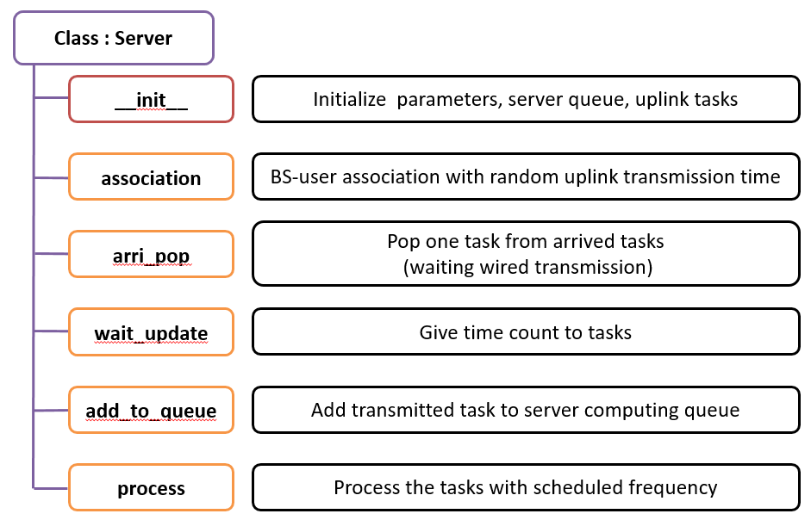
Total structure

Slide 10
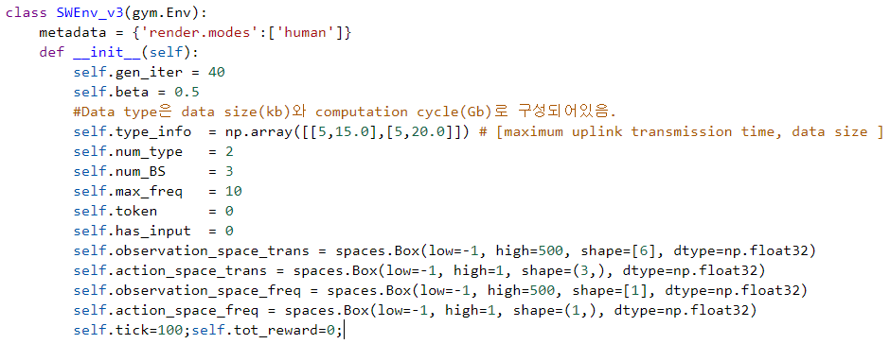
Env code - environment
__init__ (self)

Slide 11
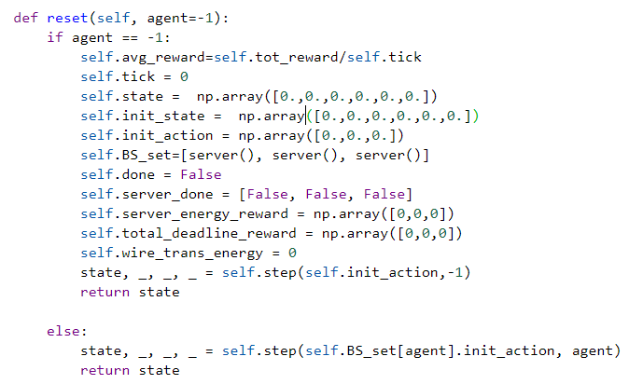
Env code - environment
reset (self, agent = -1)
center
server

Slide 12
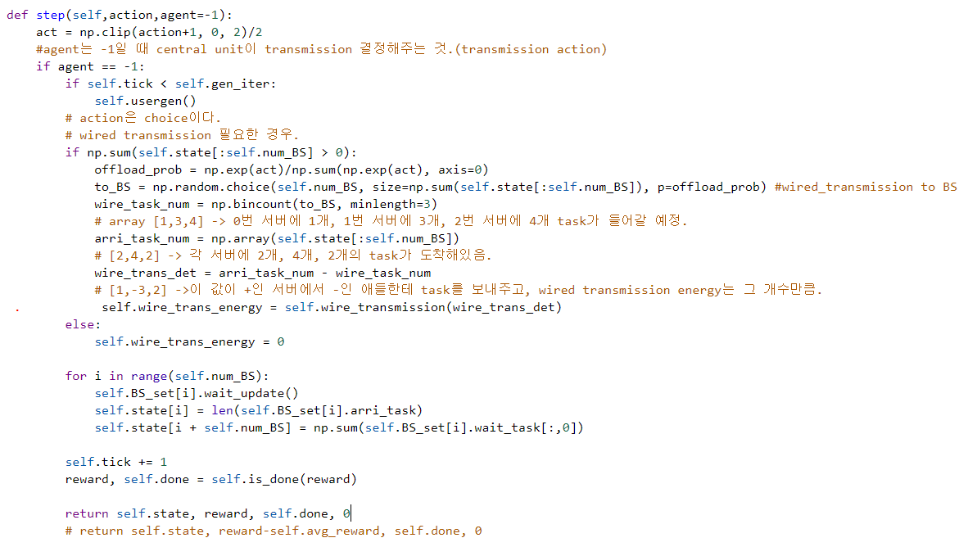
Env code - environment
step (self, action, agent = -1) : center agent (agent == -1)

Slide 13
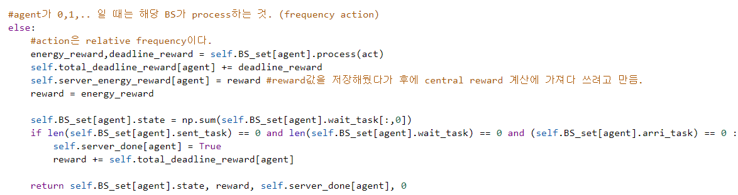
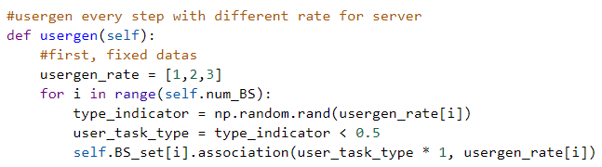
Env code - environment
step (self, action, agent = -1) : server agent (agent != -1)
usergen (self)

Slide 14
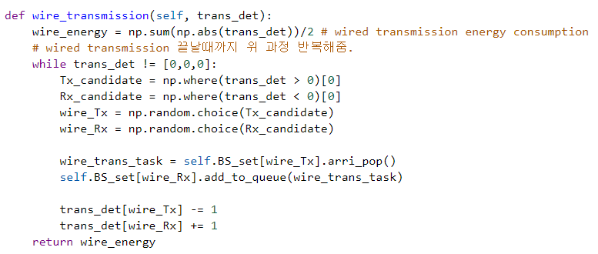
Env code - environment
wire_transmission (self, trans_det)

Slide 15
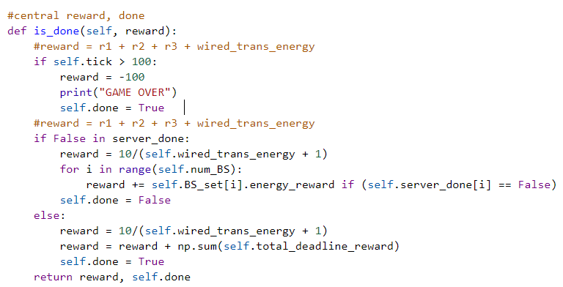
Env code - environment
is_done (self, reward)

Slide 16
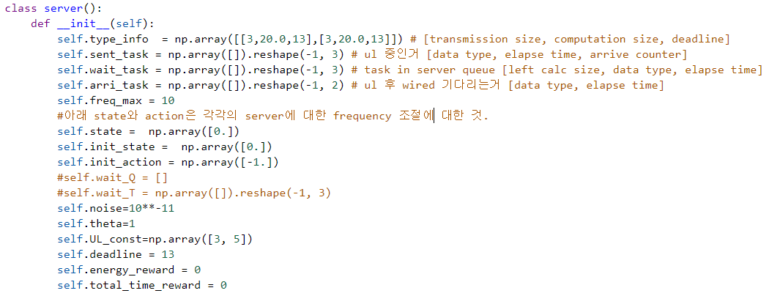
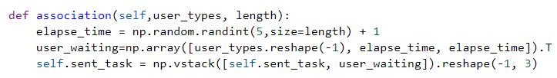
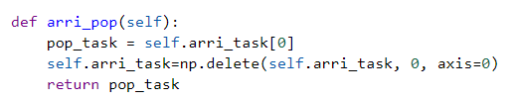
Env code - server
__init__ (self)
association (self, user_types, length)
arri_pop (self)

Slide 17
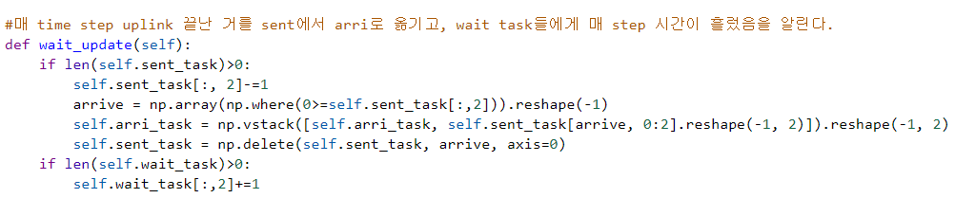
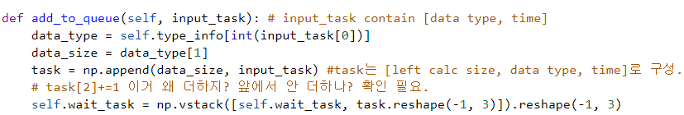
Env code - server
wait_update (self)
add_to_queue (self, input_task)

Slide 18
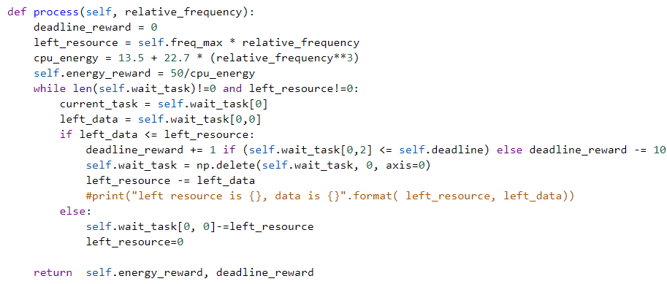
Env code - server
process (self, relative_frequency)

Slide 19
Thank you
Any Questions?
Email : lion4656@dgist.ac.kr

